Slide 1

Ergonomics Sembreak Week 2

Slide 2
What had been discussed last week
Reframe our research
Try using Openpose to extract coordinates

Slide 3
Timeline
Content | Date | Progress
Learning Basics of Deep Learning | Sep 2022 | Done
Installing Alphapose/Openpose | Sep-Oct 2022 | Done
Learning Ergonomics Basics | Oct-Nov 2022 | Done
Forming a Framework of Time Continuous Cumulative Fatigue
Preparing for Final Exam | Nov-Dec 2022 | Done
Review the Time Continuous Cumulative Fatigue Framework | Dec 2022
Trying to Extract Coordinates Using Alphapose/Openpose | Dec 2022
Adding on a Cumulative Fatigue Assessment using Alphapose/Openpose with Python | Jan-Mar 2023
Writing a Technical Report for our Research | Mar 2023

Slide 4
Reframe Research Framework due to Limited Data
Title:
Visual-Based Cumulative Ergonomics Assessment using Computer Vision with Deep Learning
Aim:
Analysing the ergonomics characteristics of expert masons from the perspective of cumulative damage assessment, compare the results to the results in paper Ergonomic Characteristics of Expert Masons JuHyeong Ryu, A.M.ASCE1; Bennett Banting2; Eihab Abdel-Rahman3; and Carl T. Haas, F.ASCE4. Justification:
This research direction is meaningful because in the last two papers, we can tell from the data that the working posture of an expert mason causes the lowest compression force and moments at the respective body parts. However, the expert may not realize that their certain postures are proper postures, therefore they cannot efficiently teach the apprentices. Hence, a scientific analysis can help us to collect proper postures and train the beginners in a more systematic way.

Slide 5
Ergonomics Characteristics of Expert Masons
Aim: To understand the ergonomic characteristics of expert masons through biomechanical analysis of 7 common masonry activities which are risky to masons, in order to adopt their skillsets for beginner masons
Motion Capture
Data Collection and Processing
Biomechanical Analysis

Slide 6
Motion Capture
IMC System
Calibration Directed by motion capture software (Axis Neuron)
17 IMUs
3D Coordinates

Slide 7
Data Collection and Processing
1
First Course
2~6
Standard Wall
Session 1
6~7
Reinforced Wall
8~10
Constrained Space
Individual 23kg
2~6
Session 2
Colab 23kg
Standard Wall
Colab 35.2kg

Slide 8
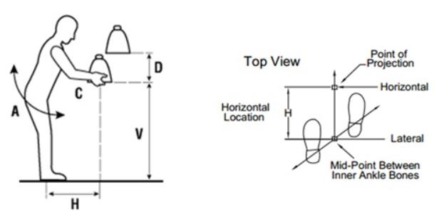
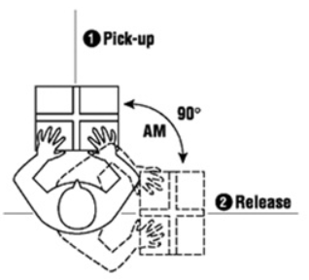
Biomechanical Analysis — 1st Session
Action Limit
~ Safety Force Limit Derived from NIOSH Lift Equation
RWL = LC x HM x VM x DM x AM x FM x CM
Symbol | Meaning
LC | Load Constant (23kg or 51lbs)
HM | Horizontal Location of the object relative to the body
VM | Vertical Location of the object relative to the floor
DM | Distance the object is moved vertically
AM | Asymmetry Angle or twisting requirement
FM | Frequency and Duration of lifting activity
CM | Coupling or quality of the workers grip on the object
https://ergo-plus.com/niosh-lifting-equation-single-task/

Slide 9
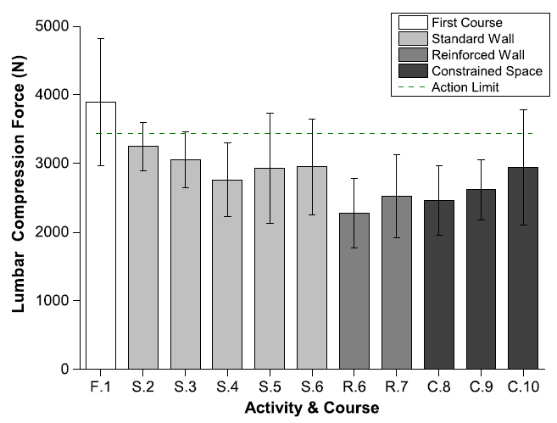
Biomechanical Analysis — 1st Session
Lumbar Compression Force
First Course
Largest Force
Standard Wall
Constant Force
Reinforced Wall
Level
Force
Constraint Spaces
Level
Force

Slide 10
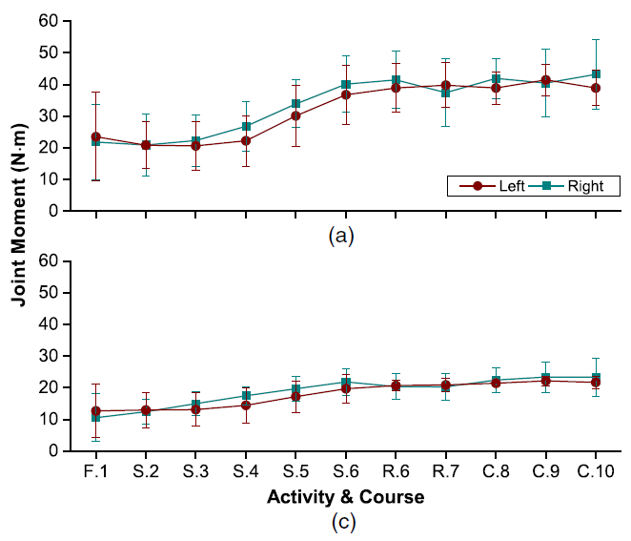
Biomechanical Analysis — 1st Session
(a) Shoulder Moment (c) Elbow Moment (They made mistake)
Shoulder Moment
Level
Forces
Elbow Moment
Level
Forces

Slide 11
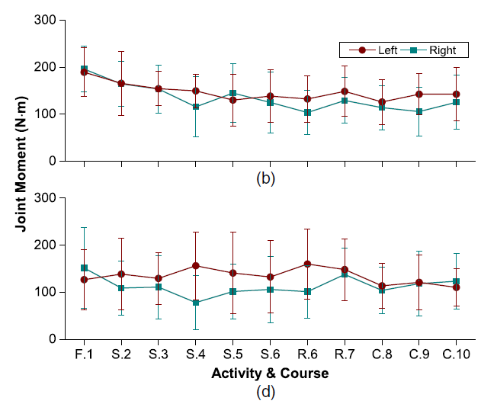
Biomechanical Analysis — 1st Session
(b) Hip Moment (They made mistake) (d) Knee Joint Moment
Hip Moment
Constant Moment
Knee Joint Moment
Constant Moment

Slide 12
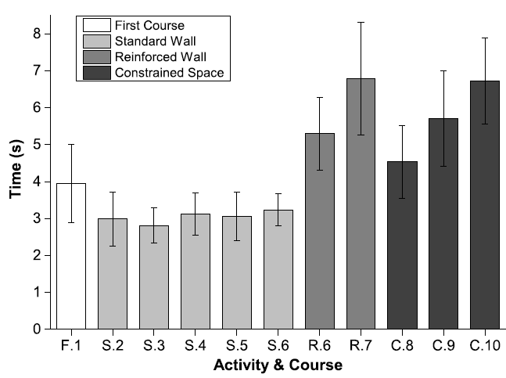
Biomechanical Analysis — 1st Session
Completion Time
Standard Wall
Constant Duration
Reinforced Wall
Level
Time
Constraint Spaces
Level
Time

Slide 13
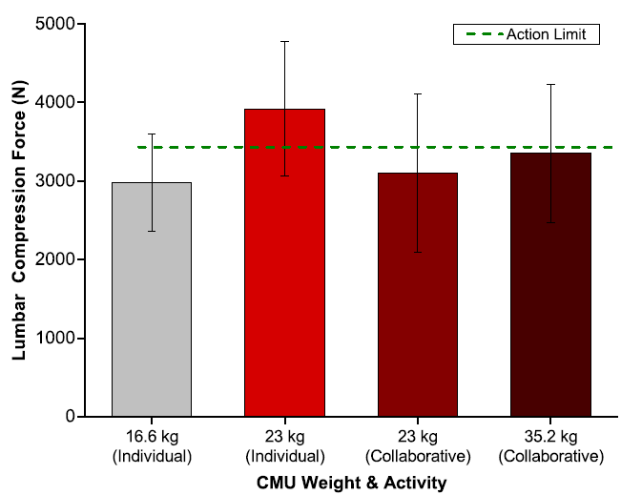
Biomechanical Analysis — 2nd Session
Average Lumbar Compression Force
Individual
Weight
Force
Collaborative
Weight
Force

Slide 14
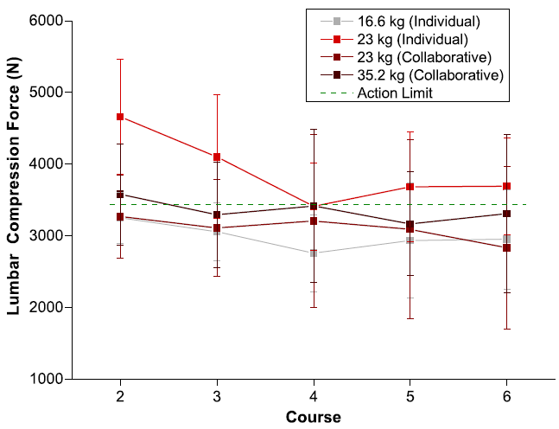
Biomechanical Analysis — 2nd Session
Lumbar Compression Force
2~4
Force decreases
4
Lowest Force

Slide 15
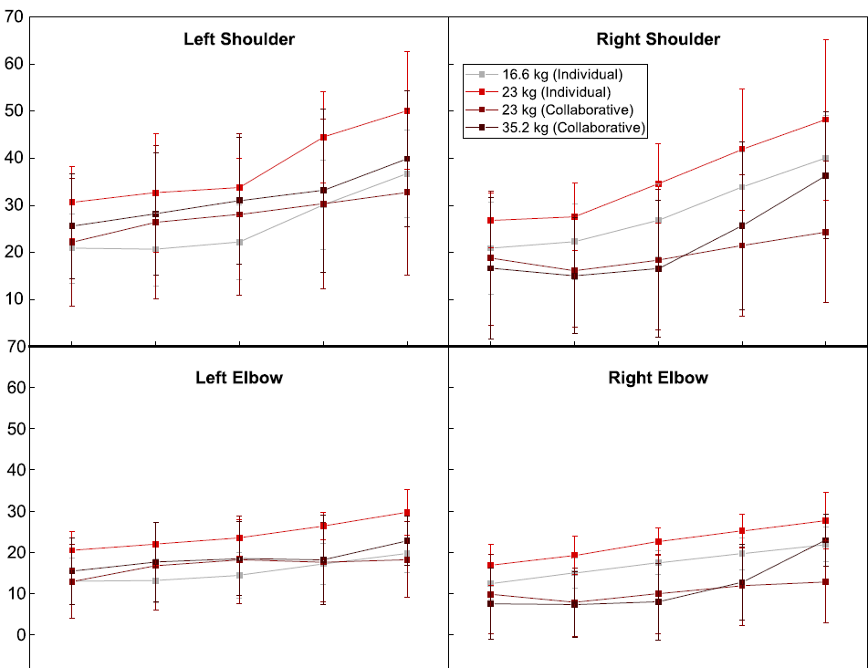
Biomechanical Analysis — 2nd Session
Shoulder Moment & Elbow Moment
Shoulder Moment
Level
Forces
Elbow Moment
Level
Forces

Slide 16
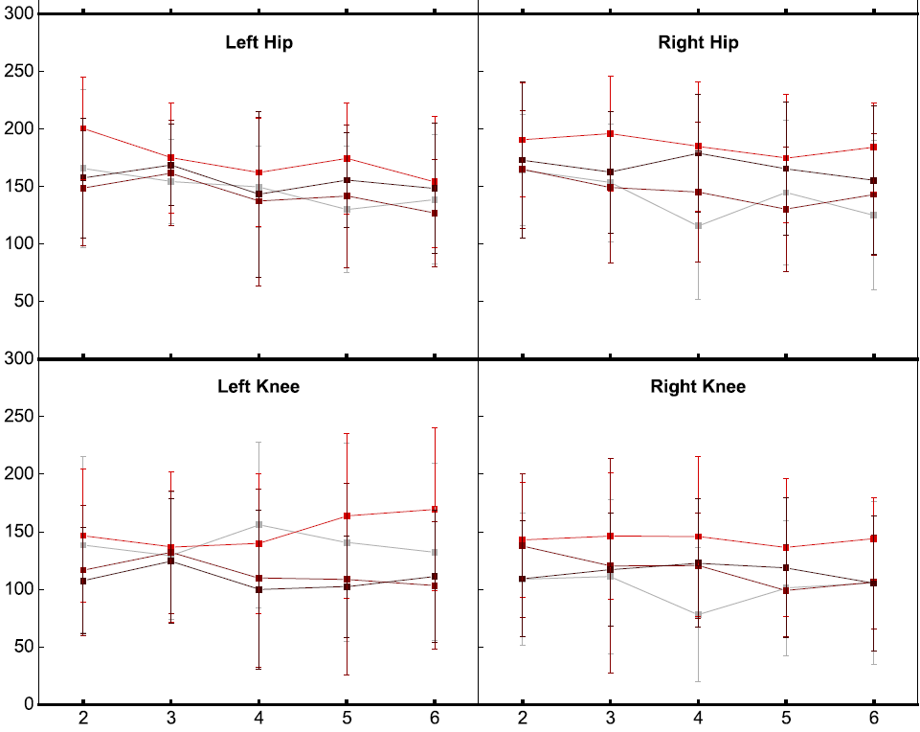
Biomechanical Analysis — 2nd Session
Hip Moment & Knee Moment
Hip Moment
Constant Moment
Knee Joint Moment
Constant Moment

Slide 17
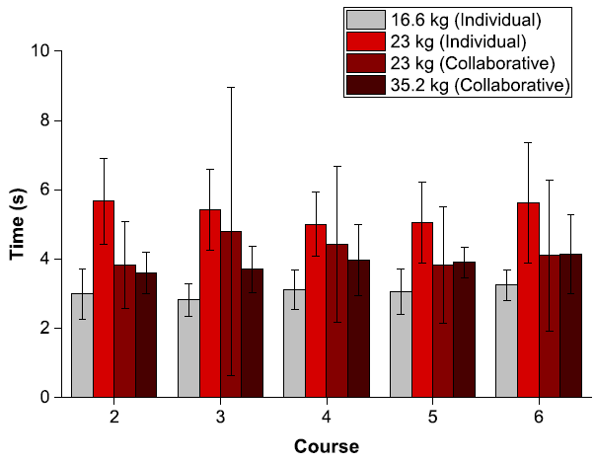
Biomechanical Analysis — 2nd Session
Completion Time
Individual
Weight
Force
Collaborative (23kg)
Varies with Level
Takes Time to Synchronize Lift Techniques
Collaborative (35.2kg)
Constant Duration
*** Note that the difference between individual and collaborative for 23kg at course 4 is least

Slide 18
Conclusion
Collaborative work is safer than individual work
The most optimal working height is the waist height (course 4)
Do not carry too heavy load even though with proper posture
Proper posture is not only safer but also more efficient

Slide 19
Challenges of This Week
Face lots of bugs when extracting the coordinates, for example cannot implement 3d rendering and webcam

Slide 20
Next Meeting
Keep trying using Openpose to extract the coordinates
Set up research question
Do the budget for Kinect camera
Data collection
Proposal for the author
What is the unit of the coordinates extracted in openpose

